Slide 1

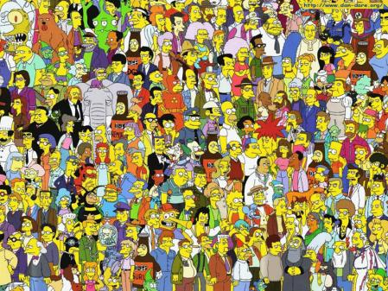
E
Adam Cole : Work Examples
Prepared for:
You
December 21, 2011
See slide notes for additional details.
Notes:
Note: On a number of slides I use the slide notes to describe what appears on the slide.

Slide 2

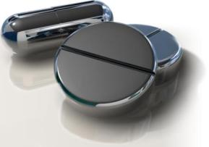
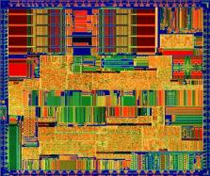



McKesson STS/P4S: Portals
McKesson Specialty Pharmaceutical Solutions  McKesson Phase 4 Solutions  McKesson Specialty Pharmaceutical Solutions  McKesson Phase 4 Solutions
Specialty  Technology  Solutions  Canada
Notes:
STS (Specialty Technology Solutions) was my division at McKesson. I created this presentation as a sales aid for our portal solutions.
I have modified the original presentation to be appropriate to focus on my work. I have removed slides of products where I did not play a significant role.

Slide 3
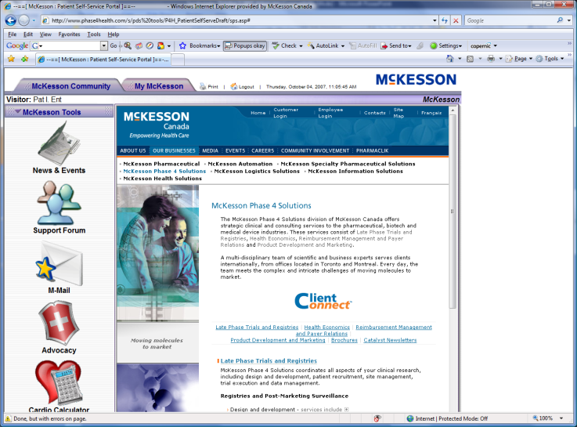
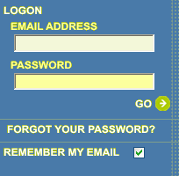

Sample Portal
New Patient
New Healthcare Practitioner
New Infusion Centre
Returning guest
Notes:
At McKesson, our customers, the pharmaceuticals, often wanted tools to build physician and patient loyalty, influence physician prescribing habits, track sales, etc. This is a prototype to build patient loyalty around a specific cancer therapy which requires monthly infusions.
On this and the following slides I did all design and graphics (other than clipart). Typically I would architect and oversee the solution development. As this was a prototype I also did the basic JavaScript and ancillary coding to provide simulated functionality. (I am an expensive resource for operational development; however, prototyping my vision is often the overall least expensive means to a quick and successful end product instead of or in conjunction with abstract specifications.)
I will include a slide towards the end with some of my more advanced client-side code to demonstrate my hands-on coding expertise.

Slide 4
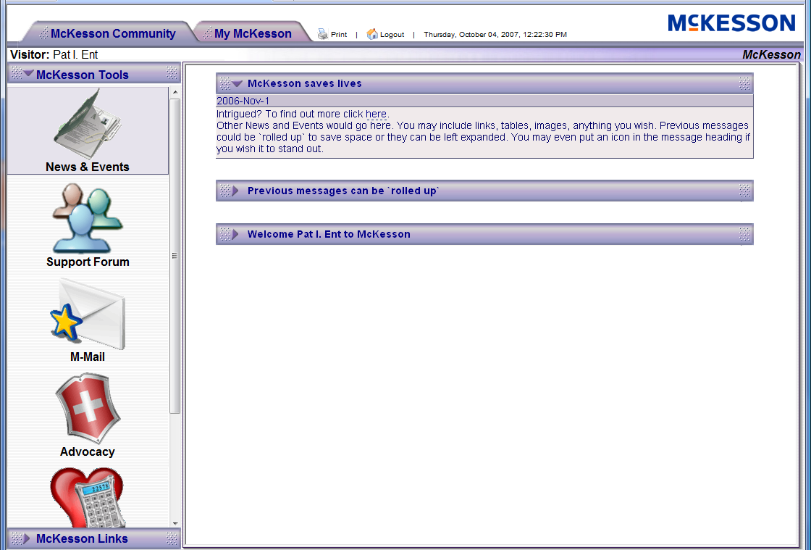
Sample Portal
Notes:
I mocked this up in one evening for a big sales presentation the following day that I was informed of last minute. It is fully functional on the client side, i.e. presentation layer only. (Icons from the web, all other graphics and layout I designed. JSON for the datastore. JavaScript for the presentation functionality and animation.)

Slide 5
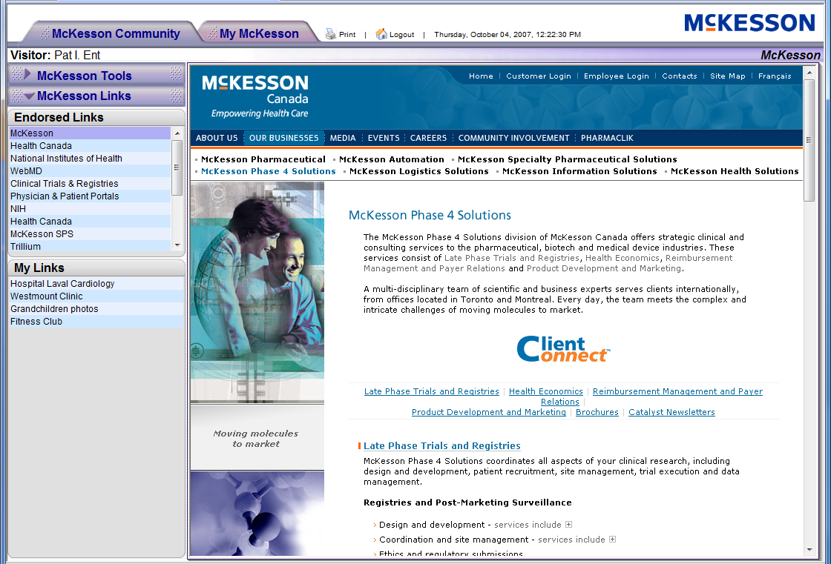
Sample Portal
Notes:
Same notes as previous slide.

Slide 6
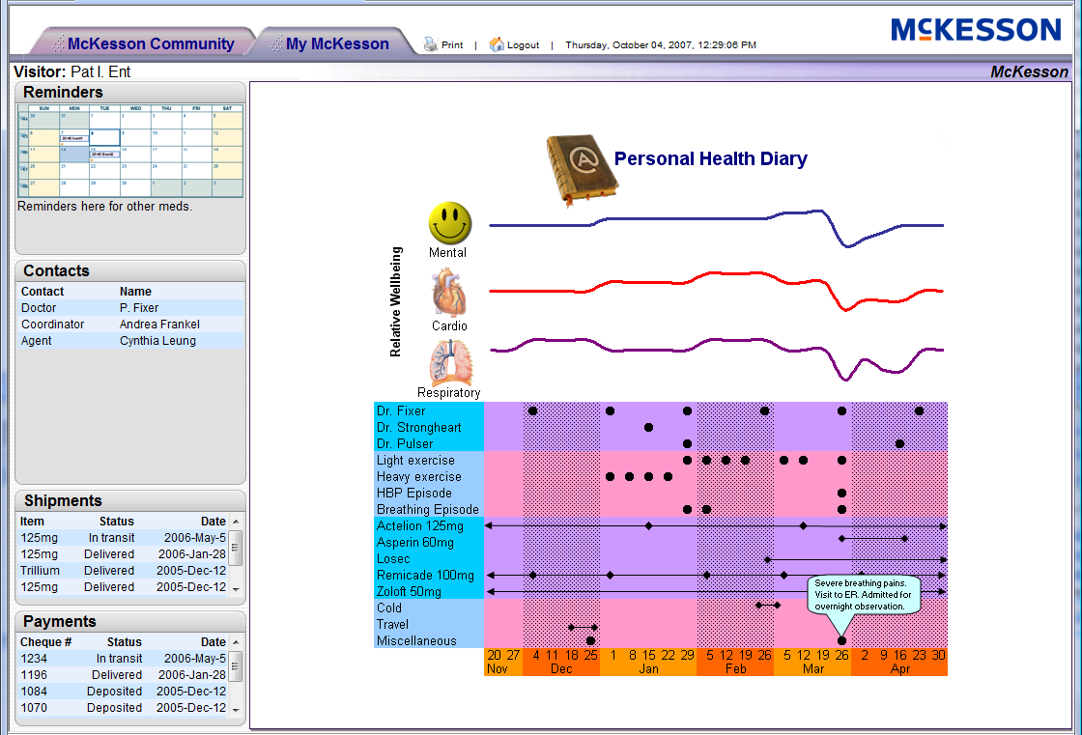
Sample Portal

Slide 7
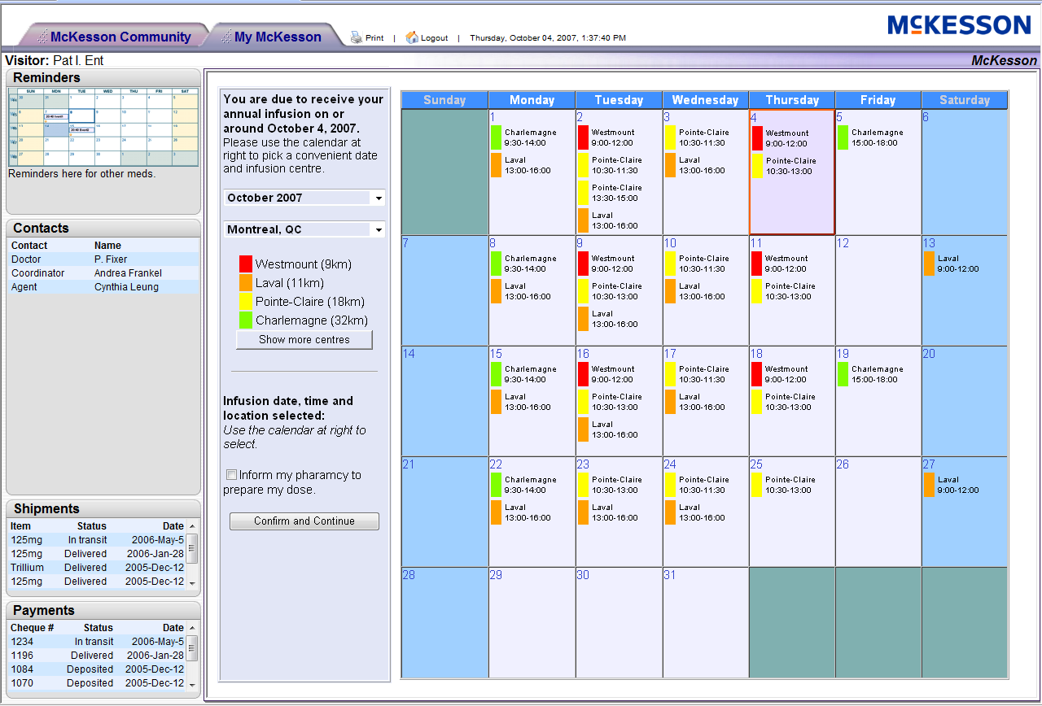
Sample Portal

Slide 8
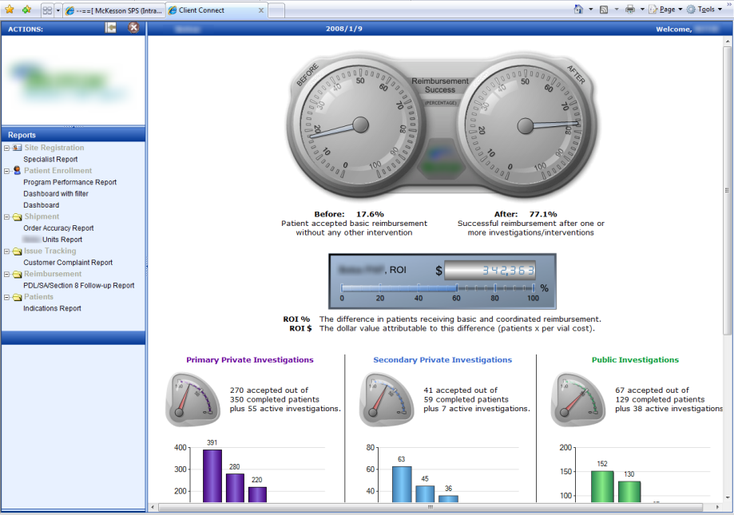
Sample Dashboard Reports
Notes:
This is a dashboard for a popular expensive cosmetic and therapeutic drug. The manufacturer was concerned about a new entrant. McKesson was commissioned to build physician loyalty and we accomplished that by helping patients get reimbursed for the drug. The two dials at the top show the reimbursement success rate before and after our involvement. The drug rep would run and print this report for a given doctor before visiting the doctor. The rep could then used the report, often with great success, in gaining the physician’s loyalty. The program included sophisticated workflow and related functionality (tracking, alerts, forms, drug shipments,…)

Slide 9
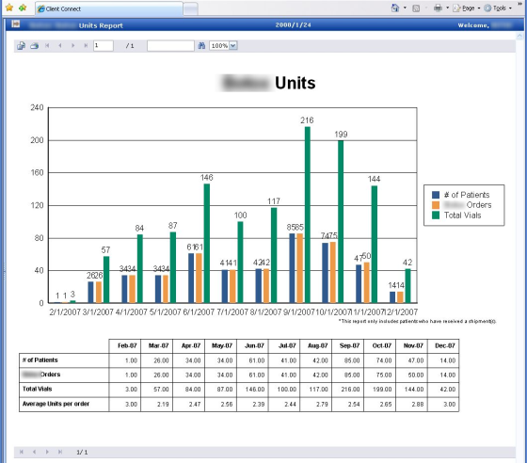
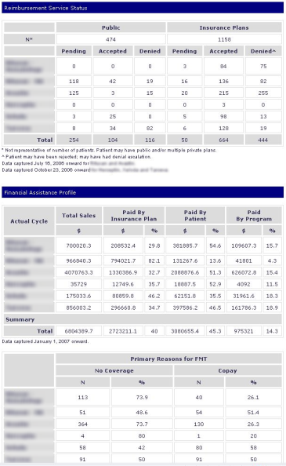
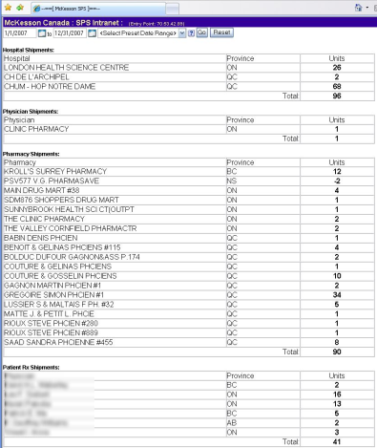
Specific Reports :: Drilldown reports from the previous dashboard

Slide 10











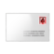



Personalized Report Delivery
Reports
Word
Excel
Acrobat
Scheduling
Date/Time
Event
Delivery Mechanism
Email
Fax
Letter
FTP
Disc
Phone
User
Notes:
The previous two slides show a reporting dashboard. This was the prototype UI for configuring automated delivery of reports. (I did this simple screen to explain to the business executives how it would work and the benefits, I then reviewed this with the development team who turned it into a functioning module.)

Slide 11
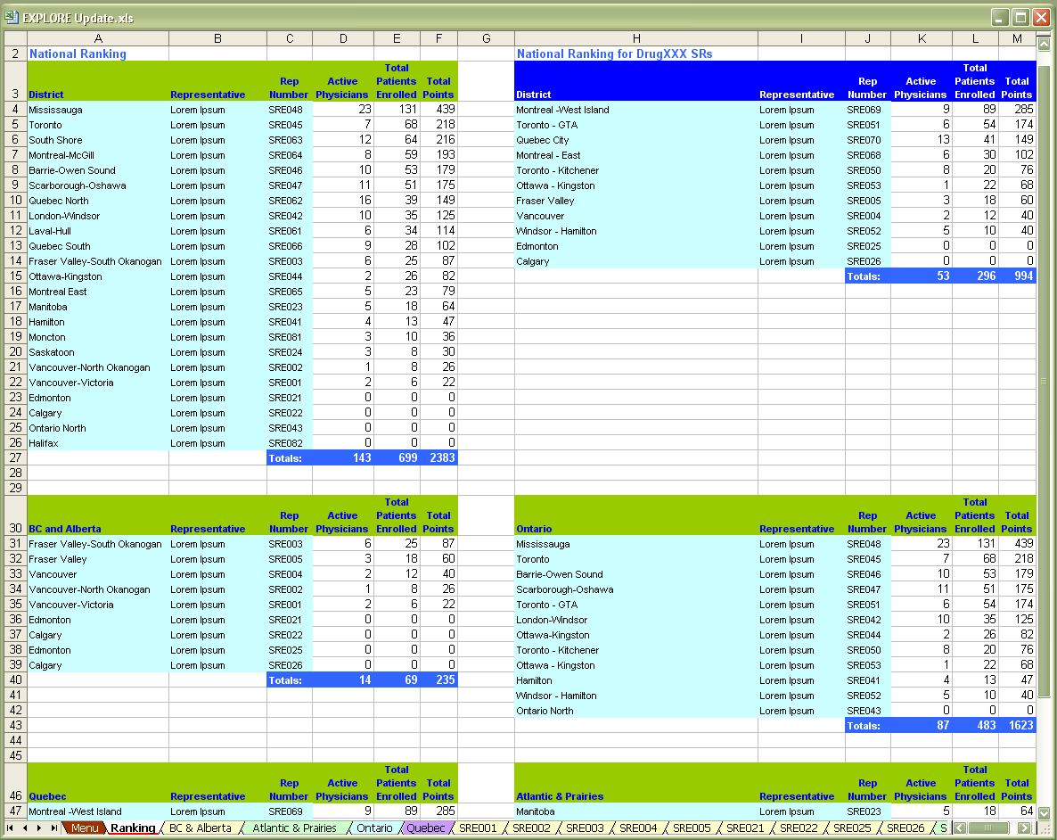
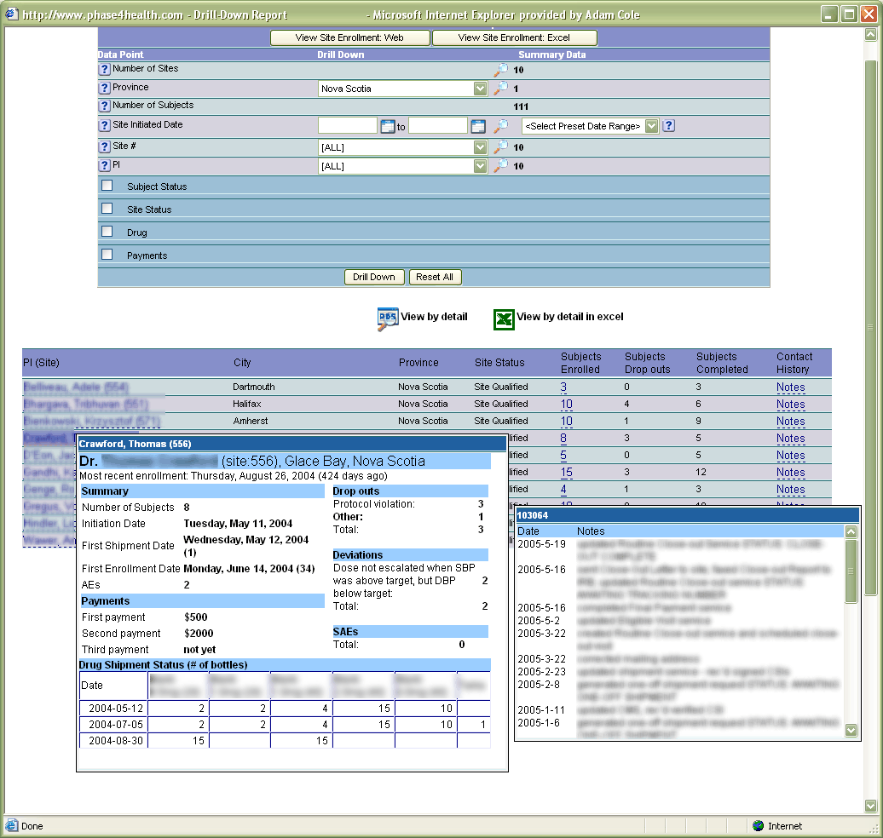
Sample Interactive Reports
Notes:
The top right image is a data-mining tool designed for a novice user. It is best to see it in action to appreciate that a casual user with no technical or prior analytics experience can do relatively sophisticated data mining without any instruction.
The bottom-left image is an Excel report generated from the data mining tool.
The following slide provides another example of the data mining tool.

Slide 12
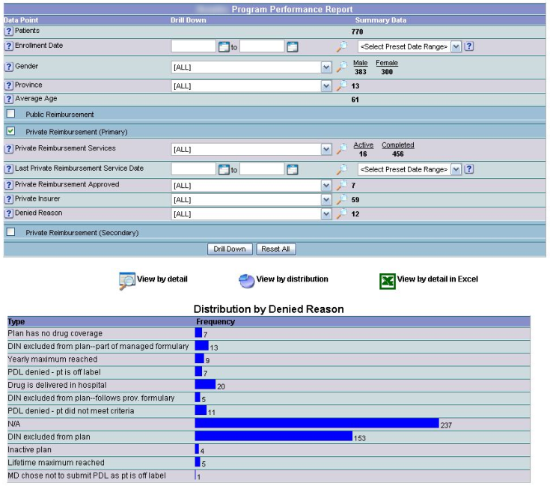
Specific Report :: Reimbursement Drilldown

Slide 13
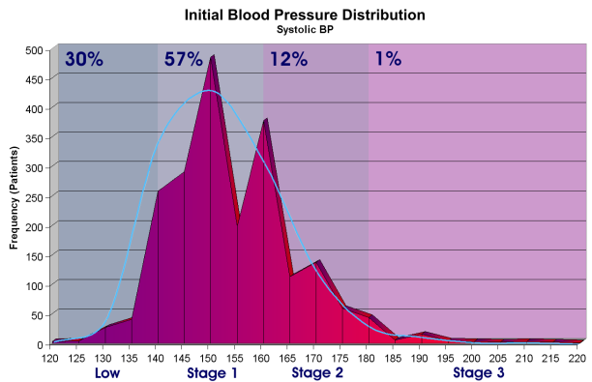
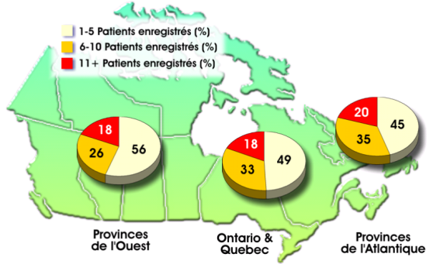
Sample Presentation-Ready Reports

Slide 14
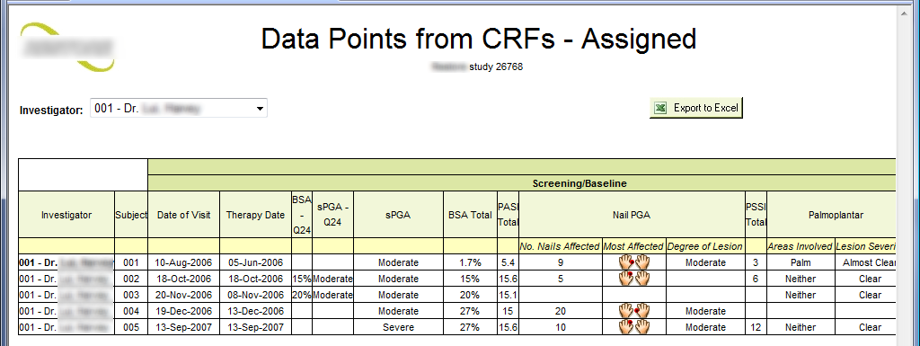
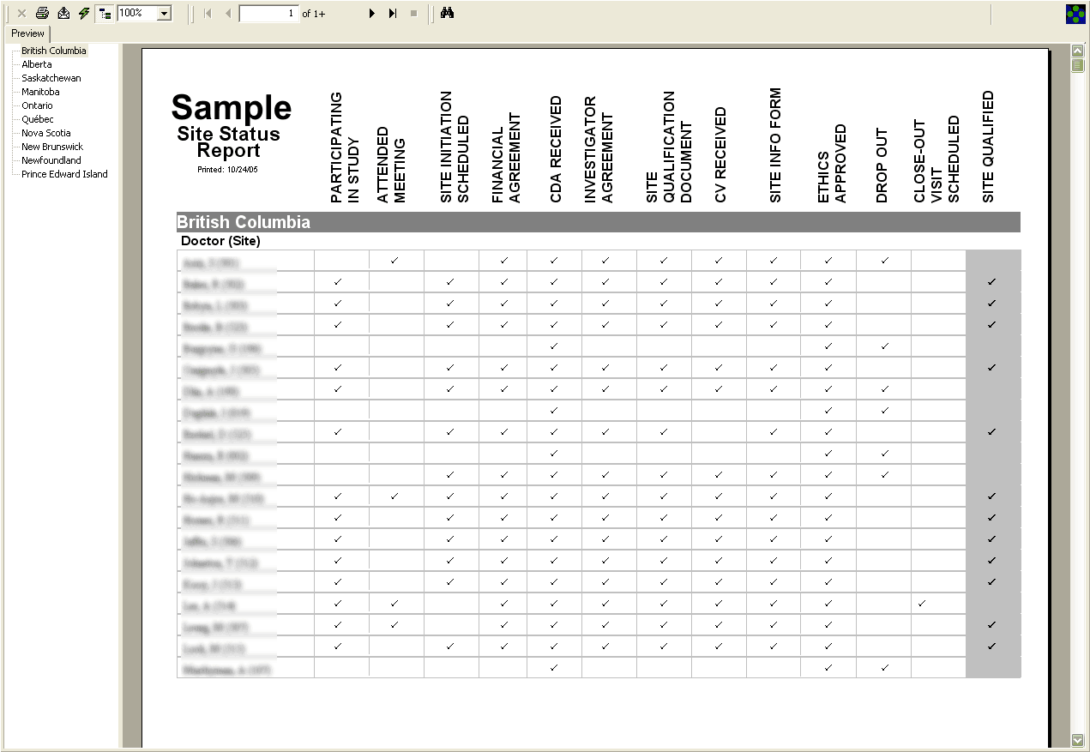
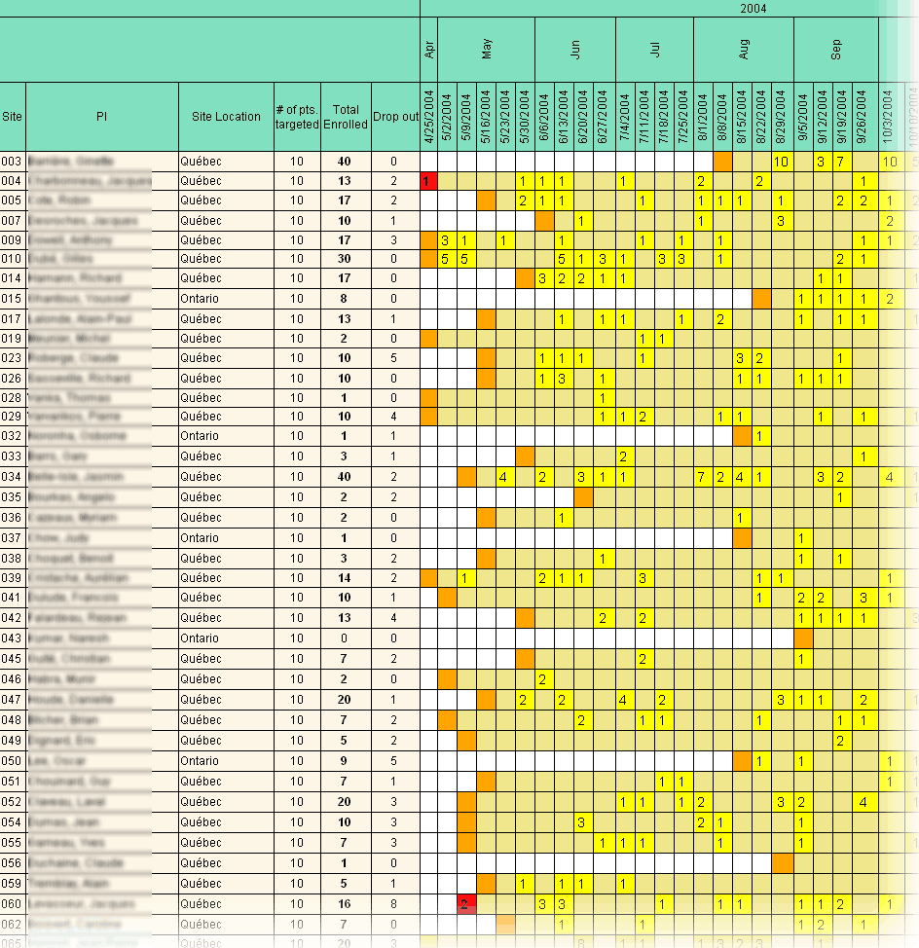
Sample Static Reports

Slide 15
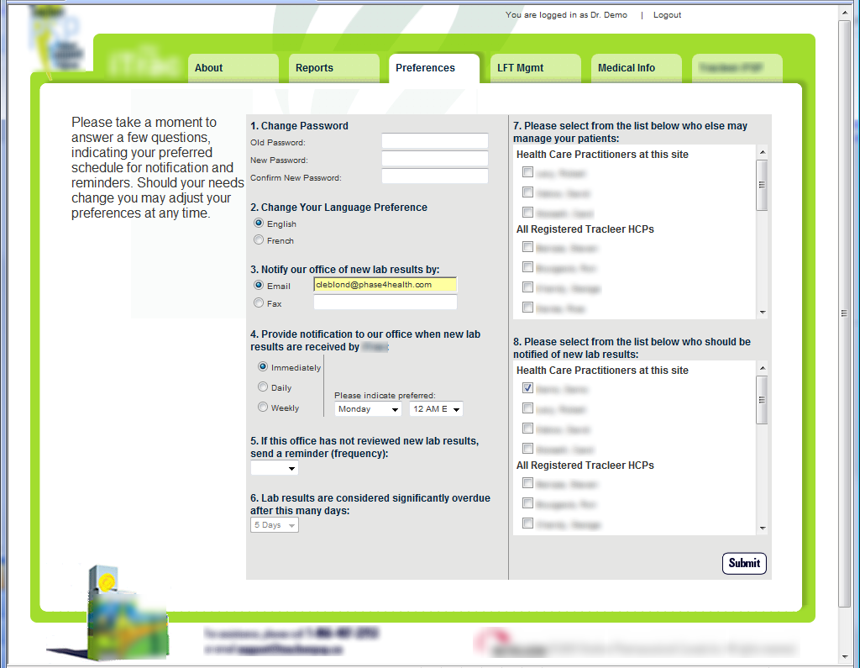
Live Physician Portal: Preferences
Notes:
This and the following slides show another physician loyalty portal. This system was also commission to fend off a new entrant. The incumbent drug had high toxicity and therefore lab management and trending was important. This portal revolved around retrieving lab results (both automatically and by fax) and storing the values in a database so that patient LFT (Liver Function Tests) could be trended over time.

Slide 16
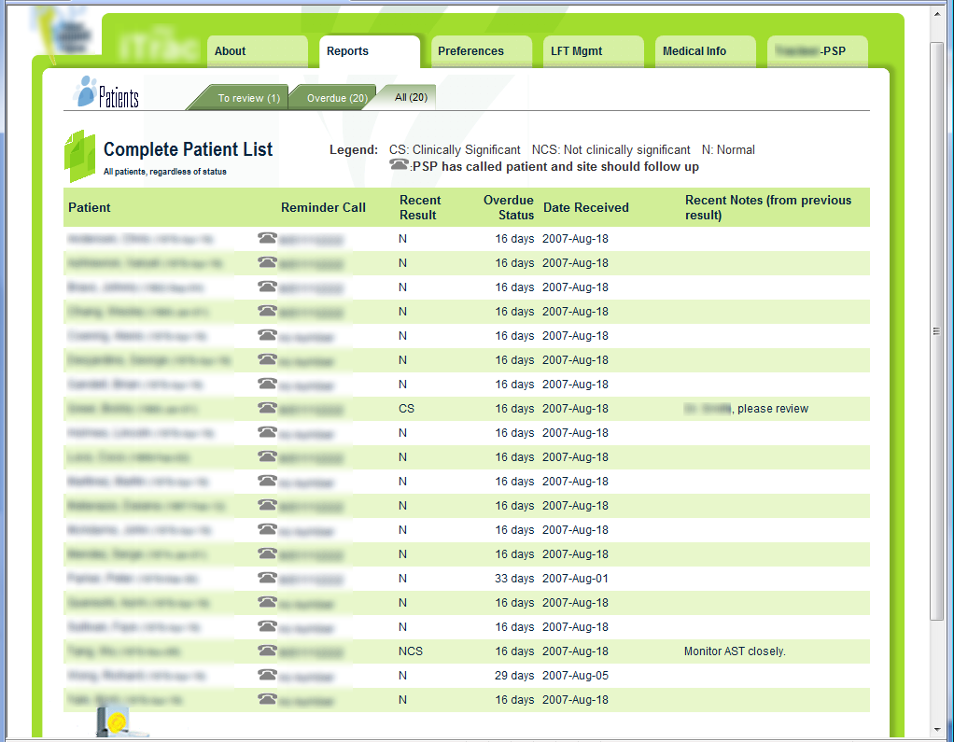
Live Physician Portal: Patient List
Notes:
Recent results with a value of “N” (normal) are reviewed by the specialists’ admin staff. The specialist need only review “CS” (clinically significant) and “NCS” (not clinically significant). This is a huge time-saver. That and the fact that lab trends are visible and the ability to share patient profiles with colleagues when the specialist is unavailable turned this into an indispensable tool for the specialists.

Slide 17
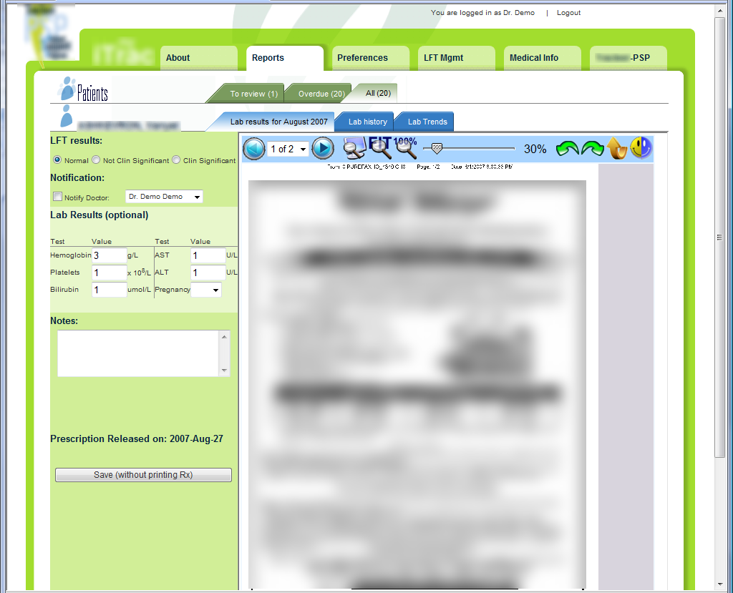
Live Portal: View Lab Results
Notes:
I architected/designed/managed the overall project. I coded the client-side fax (lab results) viewer above.

Slide 18
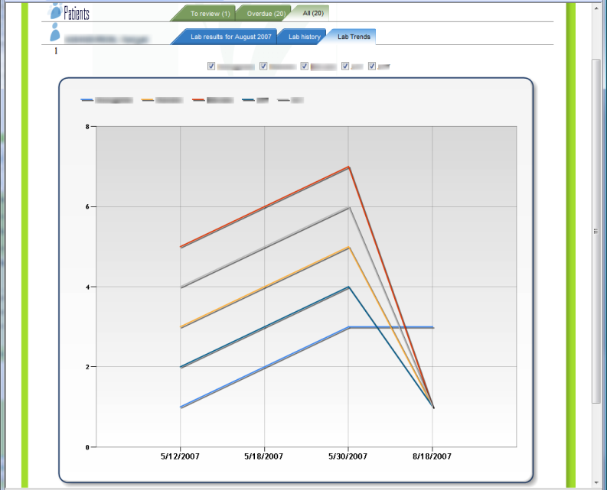
Live Portal: View Lab Trends

Slide 19
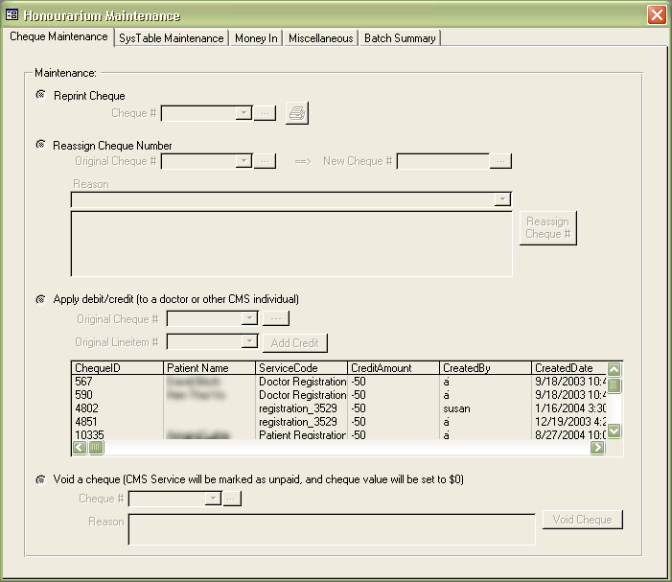
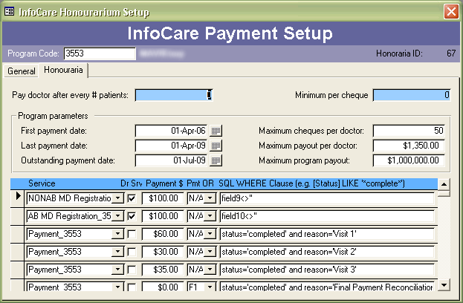
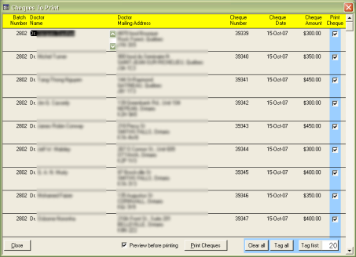
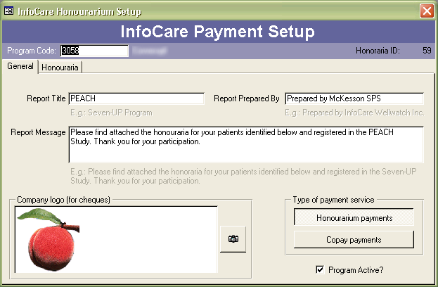
Site Payment System: Tools for Managing Honoraria
Notes:
In 2003 I built a TMS (Trial Management System). It started simple and grew quite complex. We (McKesson) considered commercializing it but decided it was a valuable strategic differentiator.

Slide 20
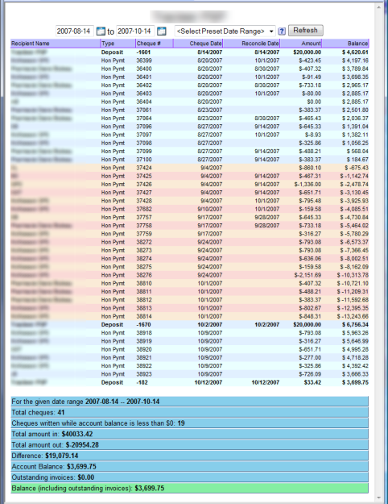
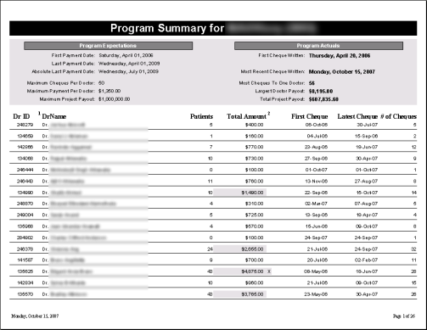
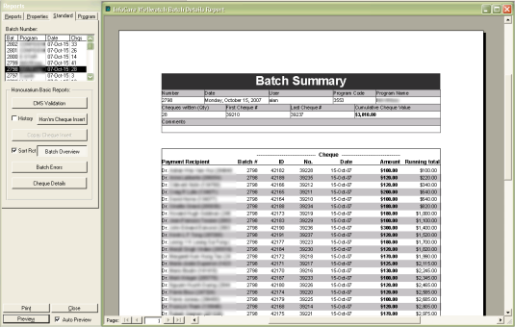
Site Payment System: Payment Reports
Notes:
The TMS payment reports. Payment management was a significant issue, we were processing over $9M across tens of thousands of honouraria cheques a year. We were holding millions of dollars in trust accounts.

Slide 21
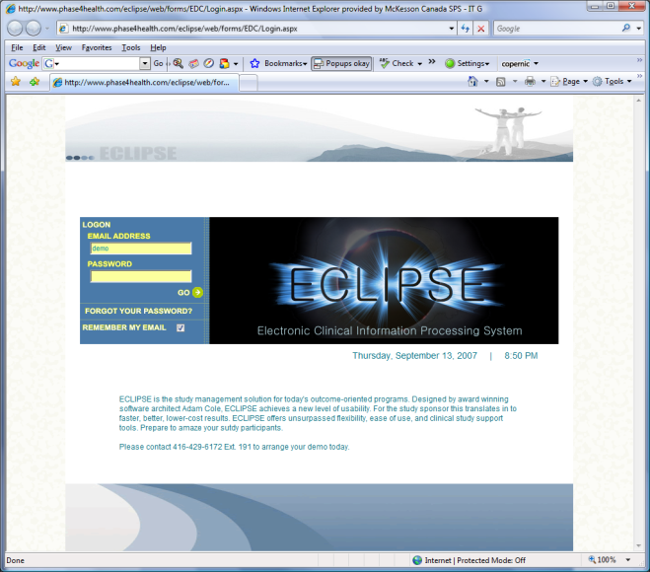
ECLIPSE: The McKesson REMS platform
Notes:
The following several slides show “ECLIPSE”, a commercial CDMS/TMS/REMS platform I built at McKesson.
The ECLIPSE CSS allowed a trial sponsor to “skin” the system according to their corporate brand. These slides show the generic skin.

Slide 22
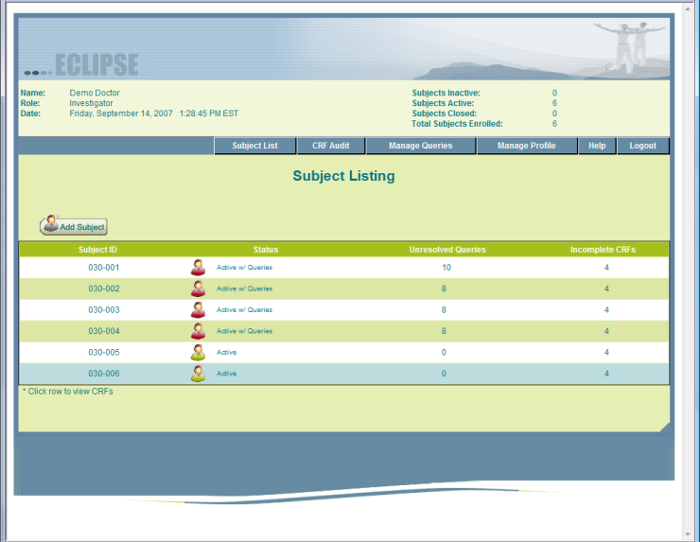
ECLIPSE: The McKesson REMS platform
Notes:
Eclipse was designed and built in 2005. Compare the UX with alternatives, particularly the market leader Oracle Clinical.
Compliance with GCP (~ISO 13485), 21-CFR Part 11, GAMP, SOx, PCI
Development methodology: Meteorite (a combination of SWEBOK and McKesson’s own methodology tweaked for specific GCP/21CFR Part11 compliance)

Slide 23
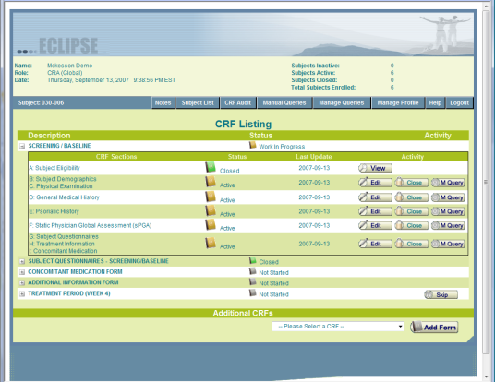
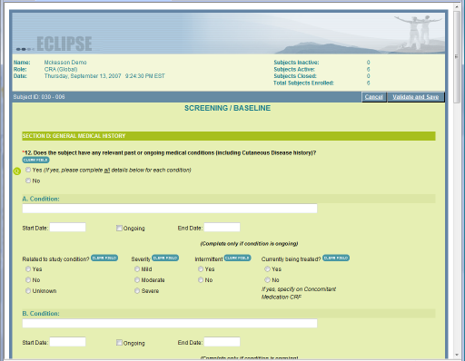
ECLIPSE: The McKesson REMS platform
Notes:
Case book / CRF (Case Report Form) management for a given patient with sophisticated workflow (GUI designer not shown).
Dynamic forms (validated, optional double data entry, in-line queries, audit log with edit notes, single-field/multivariate/and multi-form data validation with soft and hard rules, modular controls – later versions included image maps and photos, contextual help,…)
The elegant UI belies the very complex architecture.

Slide 24
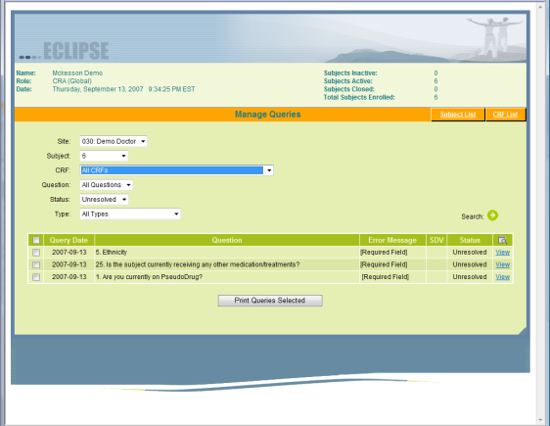
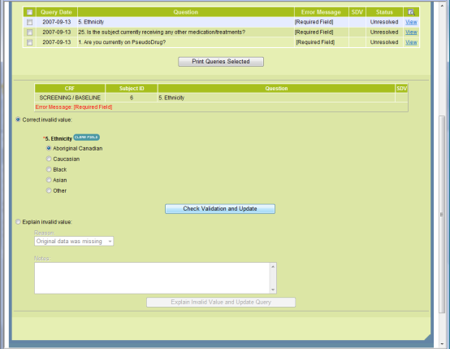
ECLIPSE: The McKesson REMS platform
Notes:
Query management. (Queries are the formal means by which integrity in clinical trials data is kept at the highest possible level.) In the above example “Ethnicity” was left blank. Before the form could be locked, the physician would either need to enter the value or explain why they left it blank.

Slide 25
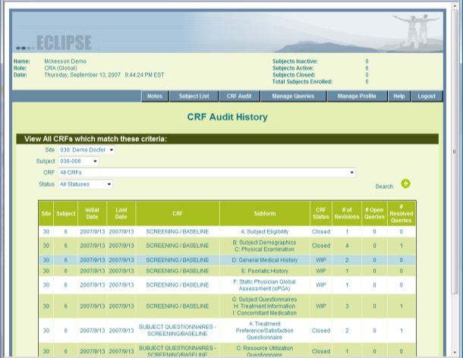
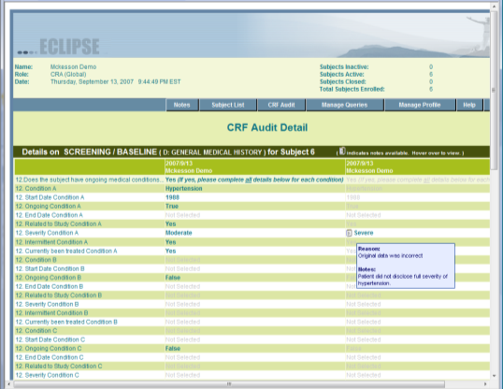
ECLIPSE: The McKesson REMS platform
Notes:
Visual audit log:
List of all CRFs
The visual change-history of a given CRF. (This was a unique feature and loved by auditors.)

Slide 26
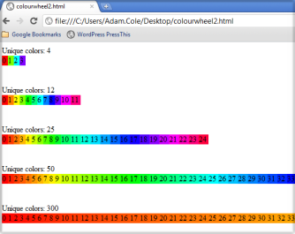
E
Adam Cole : Sample Code
Example 1
Example 2
This is an example JavaScript framework.
The first file is the framework.
The second file is a dynamic grid implementation.
All coding is my own.
Double-click to open. Save as *.js so that you can open it in a proper IDE.
I recently encountered the situation where I wanted to generate colours evenly distributed from the rainbow for use as Google Maps makers. I could not find a suitable code snippet that did exactly what I wanted so I created my own.
Here is the blog entry where I discuss it and show my simple solution: http://blog.adamcole.ca/2011/11/simple-javascript-rainbow-color.html
I am proud of this because the solution is elegant. (Do a Google search and compare to similar code examples.)

Slide 27
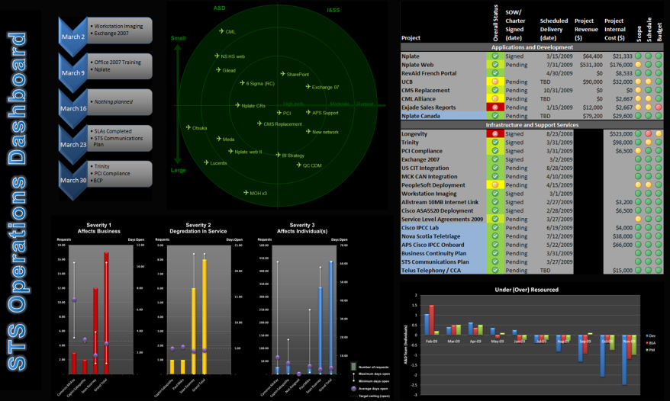
E
Adam Cole : Sample Code
The management dashboard I created for my department at McKesson…
Notes:
This report was available to all staff to give them insight into IT and project status.

Slide 28
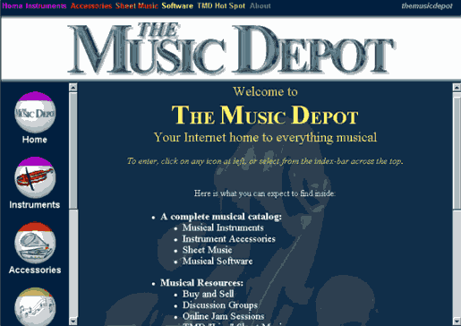
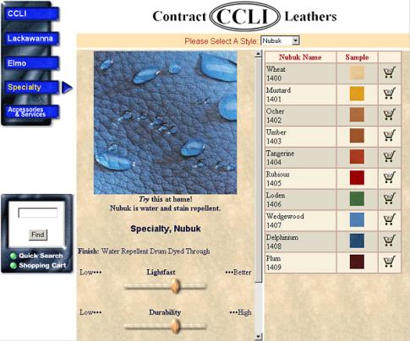
E
Adam Cole : Early Work
Here are two e-commerce websites I did in the early days of the Internet. The Music Depot was created in 1995-96 and CCLI was created in 1998.
Notes:
These sites were created for 800x600 displays in the pre-high speed Internet era. Netscape was the dominant browser and you can see in the graphics of the Music Depot that I squeezed every last byte out for efficient traversal across the typical 28.8baud modems of that era. Both sites were programmed in ASP (classic) with SQL server. LiveScript (a.k.a. JavaScript) was just emerging at the time and was implemented in CCLI. The Music Depot was so avant-garde that when the wholesaler saw the completed site they pulled out as they immediately saw this as a threat to their traditional sales channel.

Slide 29
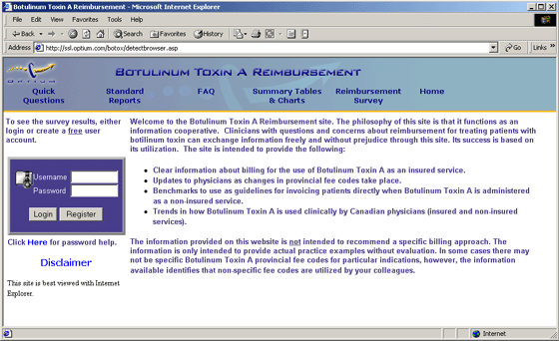
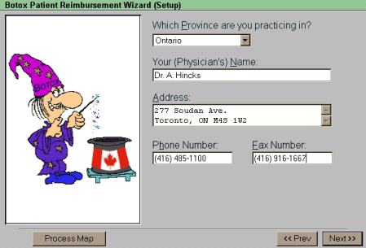
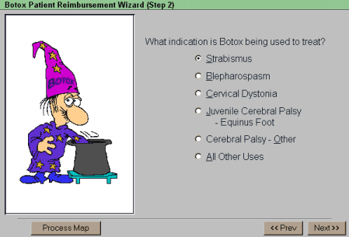
E
Adam Cole : Early Work
This Botox site was created in 1997 to help doctors navigate the complex reimbursement paths and assist with provincial and insurance reimbursement forms.

Slide 30
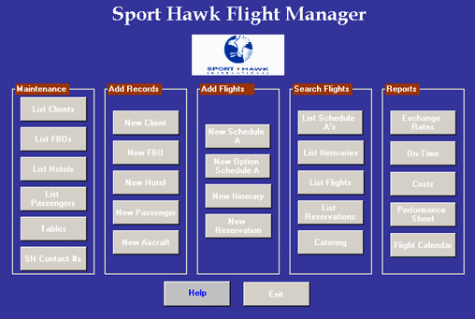
E
Adam Cole : Early Work
SportHawk was a client in the late 90s. They were an executive airline charter with a fleet of Boeing 727s converted into ultra luxury planes. Their clients were major league sports teams such as the Blue Jays, Raptors, and most American professional sports franchises.
The Flight Manager program started off simple and continuously evolved. Ultimately it kept a personal profile on all players including favorite meals in each city, favorite hotels and room requirements, ground transportation, etc. A mobile (Palm) interface was added to enable access for flight reps. Synchronization was managed via the solution we had developed for the DSMN (Diabetes Self-Management Network).

Slide 31
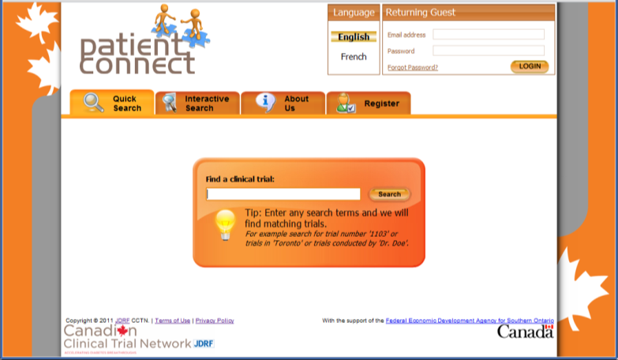
E
Adam Cole : Recent Work
Notes:
Distractions and obstacles have been ruthlessly eliminated and/or removed from focus to drive the desired user behaviour. (Compare to the multi-step process of JDRF’s flagship recruitment tool: https://trials.jdrf.org/patient/index.cfm)

Slide 32



E
Adam Cole : Recent Work

Slide 33
E
Adam Cole : Sample Testimonials
“It gives me great pleasure to recommend Adam Cole… It is my intention to introduce Adam Cole to the appropriate people in my two companies – TrizecHahn Corporation and Barrick Gold Corporation – with a view of utilizing his services for our corporate needs.”
Peter Munk, Chairman and CEO, TrizecHahn Corp; Chairman of The Board, Barrick Gold Corp.
“I have found Adam Cole to be extremely reliable. Adam has excellent interpersonal skills and working with him is
a pleasure”
Allan Detsky, Physician-in-Chief, Mt. Sinai Hospital
“[Adam] provided us with excellent products… In all cases, his work has allowed us to do some very complex tasks and analysis in an efficient manner. Adam worked very closely with us to ensure that we got not just what we asked for but what we needed. He helped us see the possibilities.”
Carole Griffen, Director Y2K Project, University Health Network
“During our relationship with Adam Cole we have come to respect his professionalism, technical expertise and friendly good service… Once again the PDS team and specifically Adam were quick to grasp our needs and requirements, efficiently putting us back on track.”
Ward Tudor Roberts, President, Canadian Contract Leathers Inc.
With respect to the DSMN: “To be able to have this kind of instant access to important healthcare information is a tremendous benefit… this leading-edge technology will revolutionize healthcare delivery in Ontario.”
Honourable James “Jim” Flaherty, Attorney General – Ontario
“Your efficiency and professionalism is exemplified in the work you have accomplished”
Aasif Khakoo, Year 2000 Contingency Planner, Toronto East General Hospital
“You are exceptionally competent, dedicated, focused and have an excellent capacity for solving complex tasks”
Jack S. Nyman, President, Nyman Investments Inc.
Notes:
These are sample testimonials from when I had my own healthcare IT consultancy. I am happy to share the complete letters upon request.

Slide 34

E
Adam Cole : Sample Accolades
Testimonials and Letters of Endorsements (Personal and for Solutions):
• Mr. Peter Munk, Chairman and CEO, TrizecHahn Corp.; Chairman of the Board, Barrick Gold Corp.
• Dr. Alan Detsky, Physician-in-Chief, Mt. Sinai Hospital
• Mr. Jack Nyman, Nyman Investments Inc.
• Ms. Carole Griffin, Director Y2K Project, UHN
• Mrs. Patricia McGowan, Systems Manager, TTH
• Dr. Dennis Daneman, The Hospital for Sick Children
• Dr. Janet Hux, Institute for Clinical Evaluative Sciences
• Dr. Margaret Lawson, Children's Hospital of Eastern Ontario
• Dr. Hui Lee, Algoma District Medical Group
• Mr. Bill MacDonald, Compaq Canada Inc.
• Dr. Colleen Metge, The University of Manitoba
• Mr. Brian Shorter, Capital Health Region, B.C.
• Dr. Robert Bear, Capital Health Authority, Alberta

